Slide 1
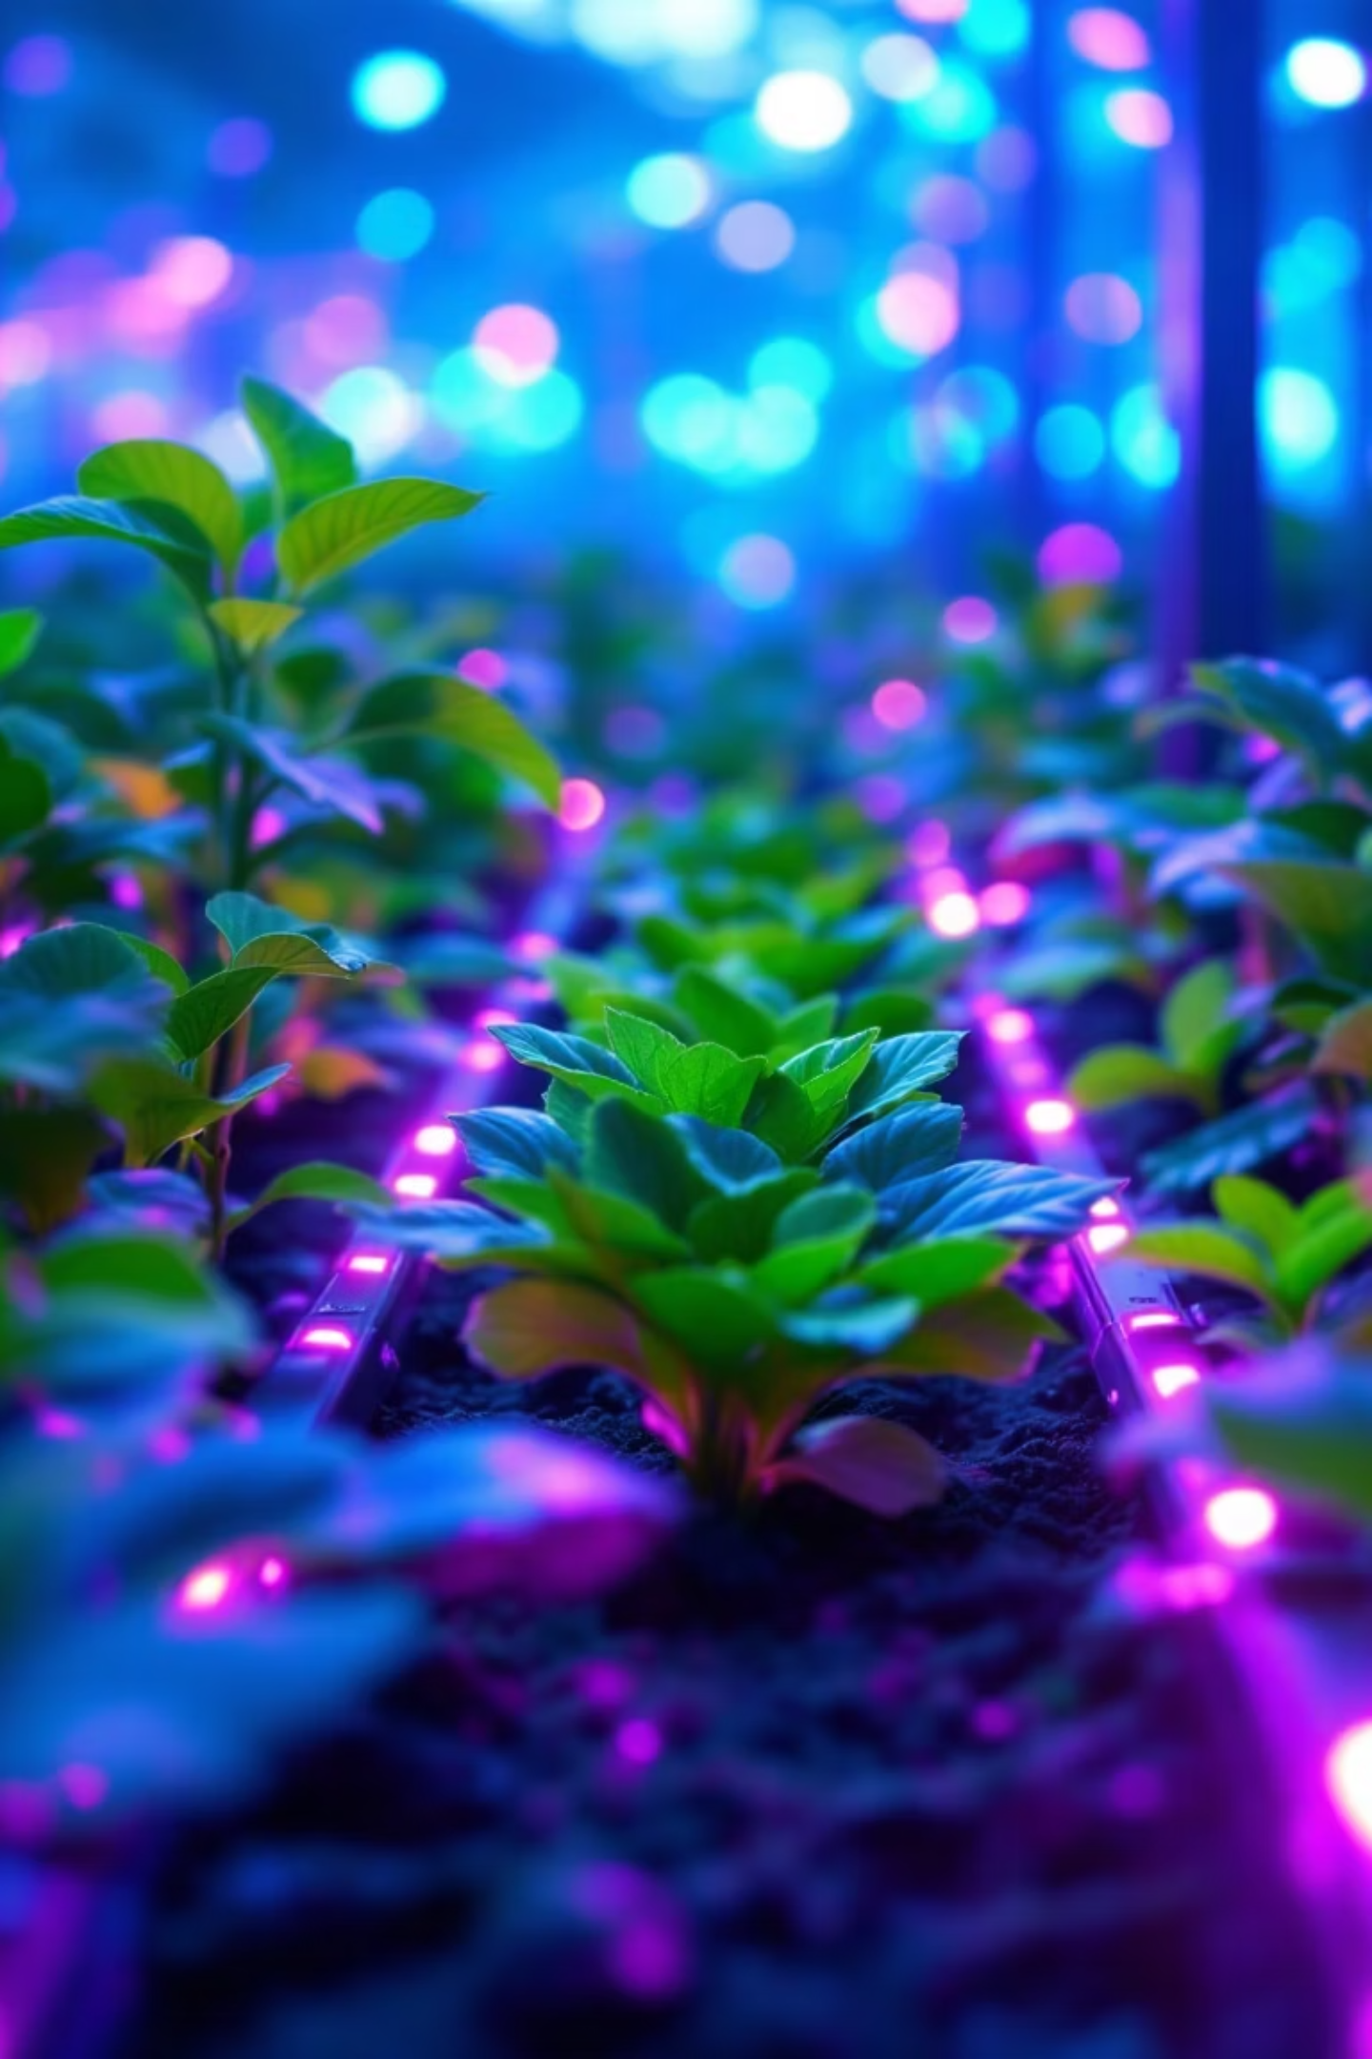

Smart Green Farm – AI Based Crop Recommendation System
AIML + DBMS Integrated Mini Project
TEAM MATE 1:
Name: DEVANSH PUROHITSAP ID: 590017030Batch: 30Submitted to: MR. KALLURI SHREEF BABU College Name: UPES
TEAM MATE 2:
Name: SURAJ PUNDIRSAP ID: 590012972Batch: 30Submitted to: MR. KALLURI SHREEF BABU College Name: UPES
Scan for App:

Slide 2

Addressing Agricultural Challenges with AI
Traditional farming methods often rely heavily on anecdotal evidence and generational knowledge, leading to suboptimal outcomes. Our project tackles these inefficiencies head-on.
Experience Over Data
Suboptimal Crop Selection
Farmers frequently make crucial decisions based on intuition rather than empirical data, leading to inconsistent results.
Incorrect crop choices for specific soil and environmental conditions drastically reduce yield and increase resource wastage.
Economic Loss
Need for Intelligent Systems
Reduced yields and inefficient resource utilization translate directly into significant financial losses for farmers.
There's an urgent demand for data-driven, AI-based solutions to guide crop selection and optimize agricultural practices.

Slide 3

Understanding the Crop Recommendation Dataset
Our AI model is trained on a comprehensive dataset, Crop_recommendation.csv, which captures the intricate relationships between environmental factors and optimal crop growth.
Core Dataset
The Crop_recommendation.csv file serves as the foundation for our machine learning model.
Input Features
Key environmental parameters include Nitrogen (N), Phosphorus (P), Potassium (K), Temperature, Humidity, pH, and Rainfall.
Optimal Crop Mapping
Each record in the dataset correlates a specific set of environmental conditions with the most suitable crop for those conditions.
Data-Driven Insights
This data enables the system to learn patterns and recommend crops that thrive under given conditions.
Placeholder: Screenshot of the Dataset
The dataset provides a rich basis for the model to understand the complex interplay of soil nutrients, climate, and crop suitability.

Slide 4


The Core of Recommendation: Machine Learning Model
Our system leverages a robust machine learning model, trained with Python and Scikit-Learn, to provide accurate crop recommendations.
Model Development
Developed using Python and powerful libraries like Scikit-Learn for efficient model training.
Persistent Model Storage
The trained model is serialized and stored as hybrid_crop_reco_model.pkl for quick deployment and inference.
Optimal Crop Prediction
The predict() method identifies the single best crop for the given input parameters.
Probability Insights
predict_proba() provides a confidence score, indicating the likelihood of other suitable crops.
Placeholder: ML Workflow Diagram

Slide 5
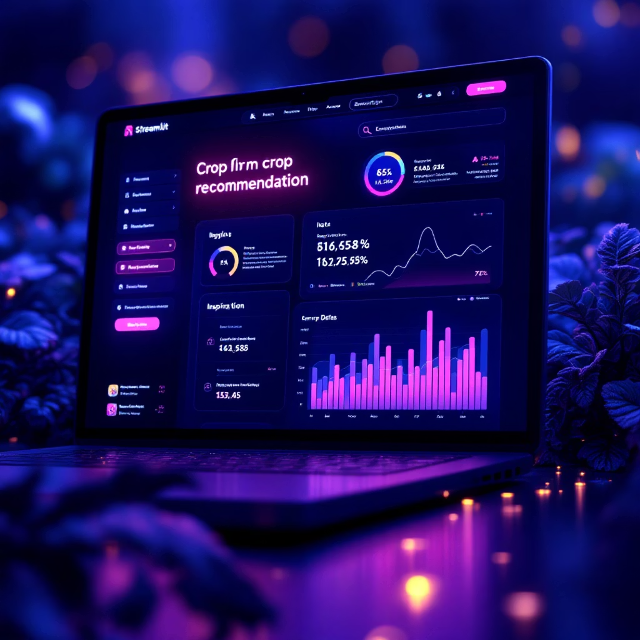
Intuitive Interactions: The Streamlit User Interface
A user-friendly web interface, built with Streamlit, allows farmers to easily input their soil parameters and receive instant crop recommendations.
Web-Based Accessibility
Accessible via any web browser, making it convenient for farmers in various locations.
Farmer Input Fields
Simple forms for entering details like N, P, K, temperature, humidity, pH, and rainfall.
Instant Recommendations
Displays the best-recommended crop immediately after data submission.
Confidence Visualization
A chart visually represents the probability scores, offering insights into alternative crop viability.
Placeholder: Streamlit UI screenshot

Slide 6

Robust Data Management: Database Design (DBMS)
A well-structured relational database underpins our system, ensuring efficient storage and retrieval of all submission data.
Relational Table
All submission data is meticulously stored in a relational table named crop_submissions.
Comprehensive Attributes
Includes farmer's name, city, state, all input parameters (N, P, K, etc.), recommended crop, probability scores, and timestamp.
Analytics & Queries
The structured data supports complex queries and enables future analytical insights into farming trends.
Structured Record Keeping
Ensures data integrity and provides a historical log of all crop recommendations.
Placeholder: ER Diagram

Slide 7


Seamless Operations: The Deployment Pipeline
Our project utilizes a modern and efficient deployment pipeline, facilitating continuous development, integration, and delivery.
Code Development
Version Control
All source code is developed and maintained within VS Code, ensuring a standardized and productive environment.
The project repository is hosted on GitHub, enabling collaborative development and robust version control.
Cloud Application
Cloud Database
The Streamlit web application is deployed on Streamlit Cloud, providing high availability and scalability.
Prediction results and user submissions are securely stored in Neon/PostgreSQL, a cloud-based database solution.
Placeholder: Deployment Diagram
Placeholder: GitHub screenshot

Slide 8
Architectural Overview: A Three-Tier System
Our Smart Green Farm system employs a classic three-tier architecture to ensure optimal performance, maintainability, and scalability.
Database Tier
Neon/PostgreSQL: Manages and stores all agricultural data and user submissions securely.
Application Tier
ML Backend: Hosts the trained AI model for crop prediction logic and processing.
Presentation Tier
Streamlit UI: Provides the interactive interface for users to input data and view recommendations.
This modular design allows for independent scaling of each component and clear separation of concerns, making the system robust and future -proof.
Placeholder: Architecture Diagram

Slide 9
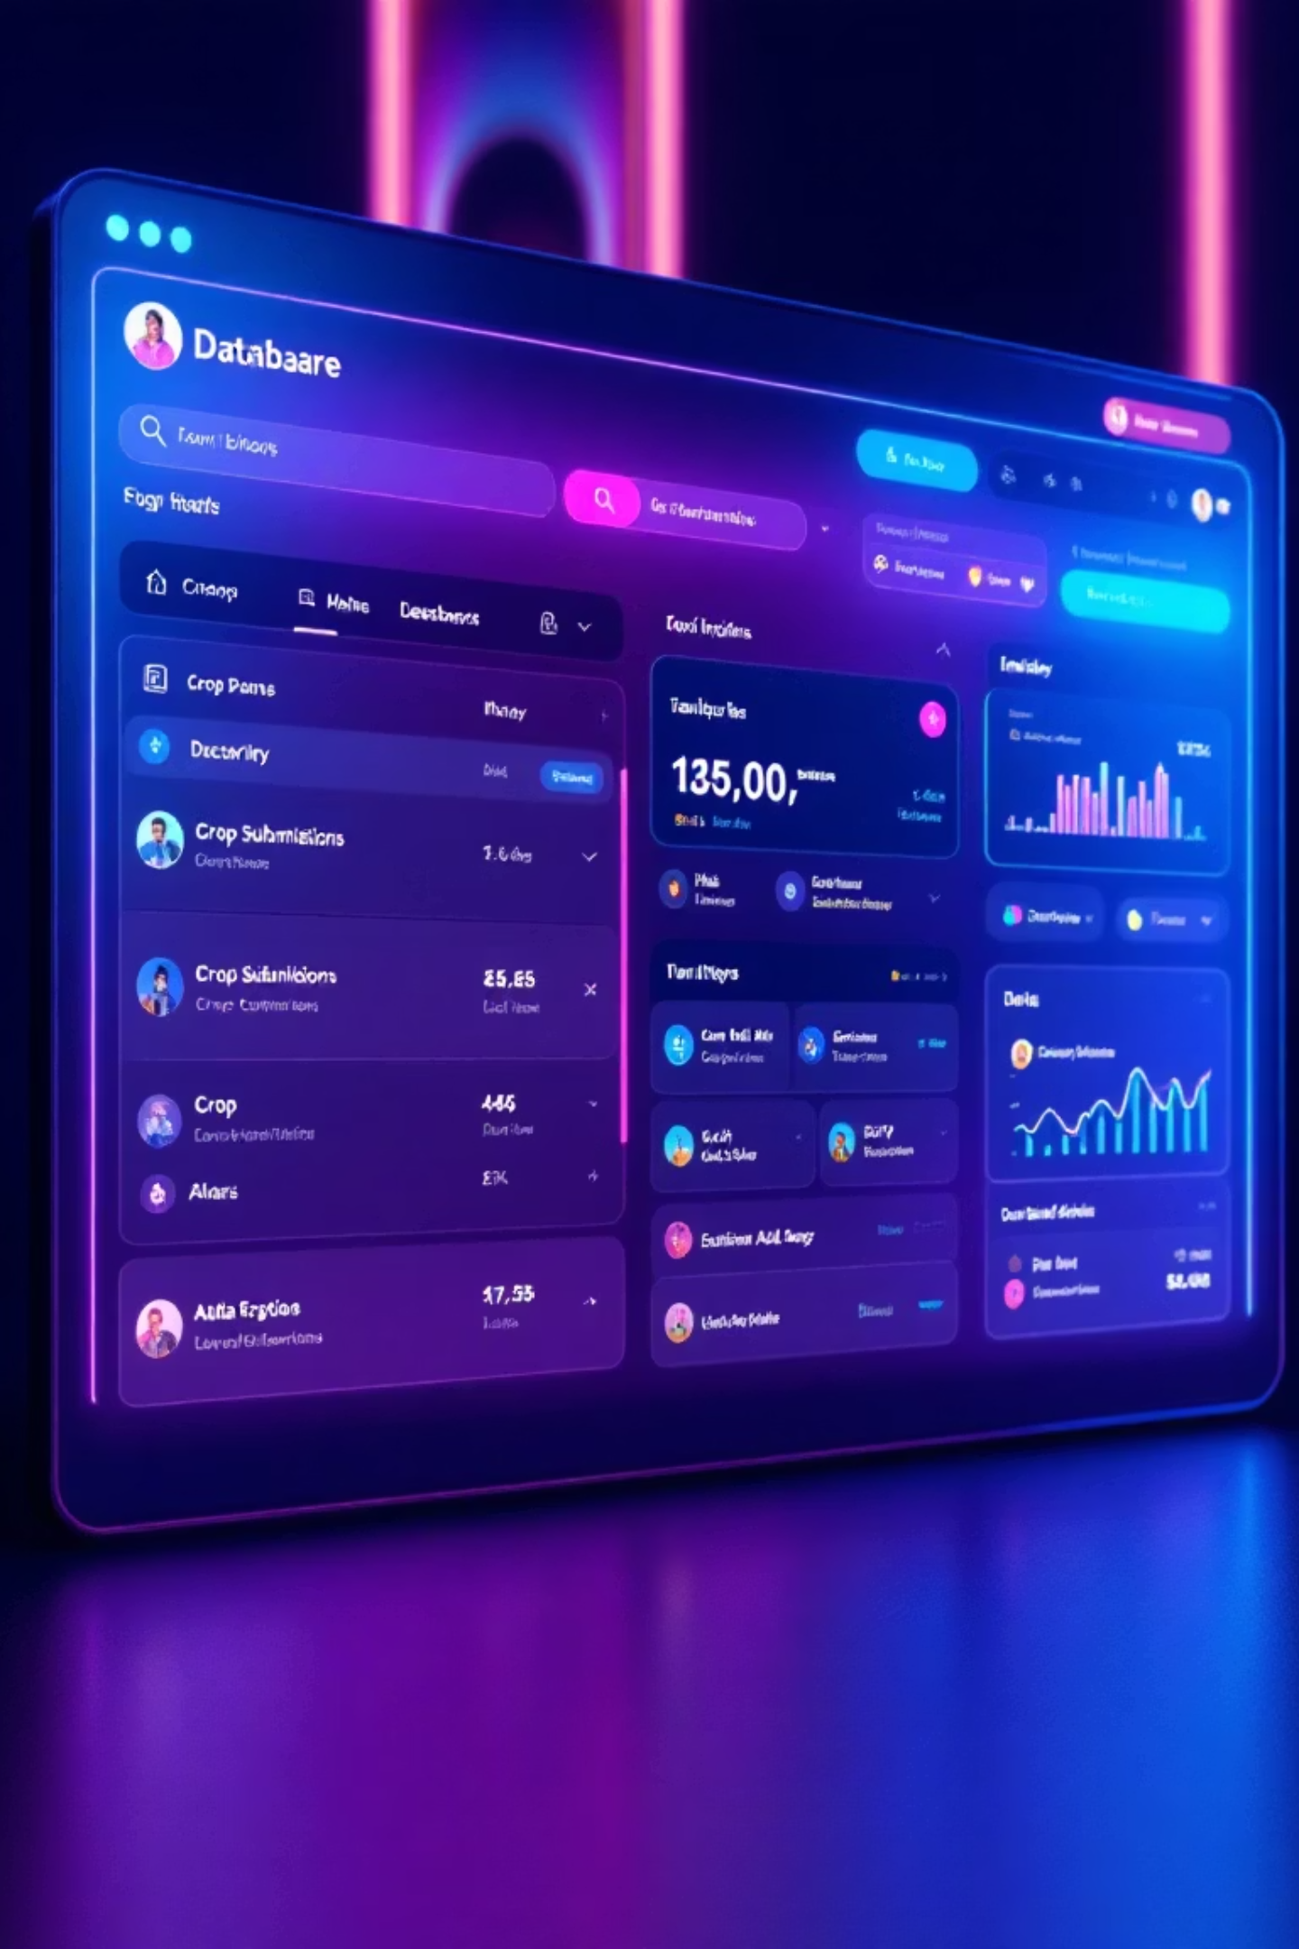

Demonstration: Real-Time Recommendations & Data Persistence
Witness the Smart Green Farm in action, providing instant, data-driven crop recommendations and seamlessly logging every query.
Instant Crop Output
See how the system quickly processes input and displays the most suitable crop.
Confidence at a Glance
Visualize the probability scores, helping farmers make informed decisions.
Automated Data Capture
Every recommendation request is automatically saved to the database for analysis.
Placeholder: Output Screenshot
Placeholder: Neon DB Screenshot

Slide 10





Future Horizons: Expanding Smart Green Farm Capabilities
The Smart Green Farm project is designed with extensibility in mind, with several exciting avenues for future development.
Yield Prediction
Disease Detection
Develop algorithms to forecast crop yields based on historical data and environmental factors.
Integrate CNN models for early and accurate identification of crop diseases.
Live Weather Integration
Connect with weather APIs to provide real-time conditions for dynamic recommendations.
Regional Optimization
Refine recommendations for specific geographical regions, accounting for micro-climates.
Mobile Application
Create a dedicated mobile app for farmers, offering on-the-go access and recommendations.
These enhancements will transform Smart Green Farm into an even more comprehensive and indispensable tool for modern agriculture.

